Slide 1
Problem statement
E-retail factors for customer activation and retention: A case study from Indian e-commerce customers.

Slide 2
Customer satisfaction has emerged as one of the most important factors that guarantee the success of online store; it has been posited as a key stimulant of purchase, repurchase intentions and customer loyalty.
A comprehensive review of the literature, theories and models have been carried out to propose the models for customer activation and customer retention.
Five major factors that contributed to the success of an e-commerce store have been identified as: service quality, system quality, information quality, trust and net benefit.
The research furthermore investigated the factors that influence the online customers repeat purchase intention.
The combination of both utilitarian value and hedonistic values are needed to affect the repeat purchase intention (loyalty) positively.
The data is collected from the Indian online shoppers.

Slide 3

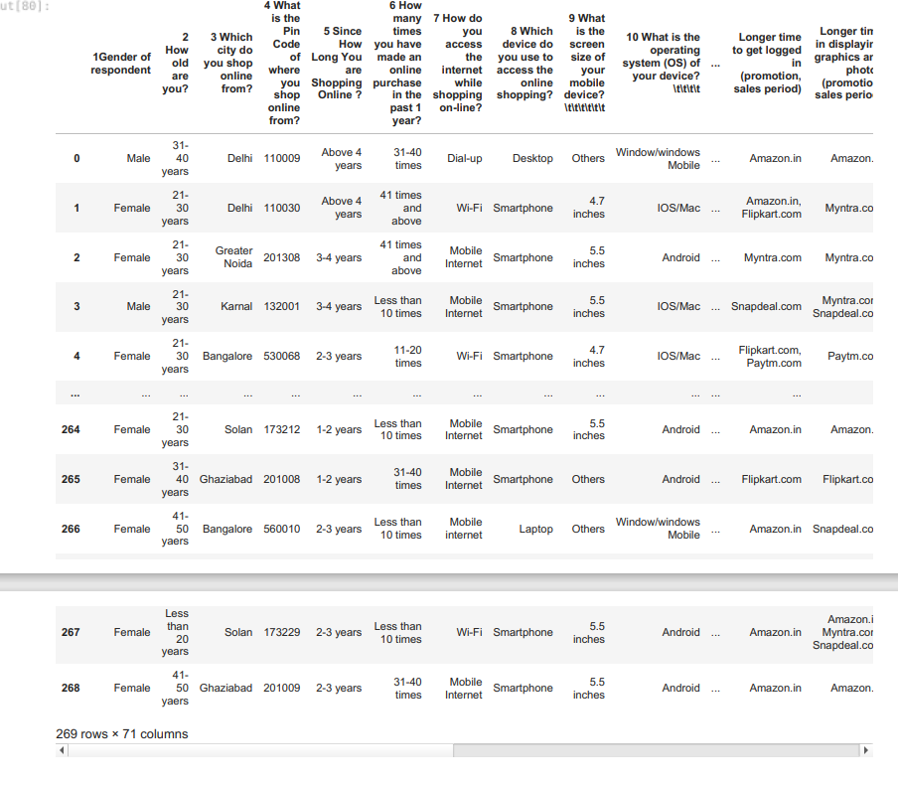
Importing libraries and load the dataset
import pandas as pd
import numpy as np
import matplotlib.pyplot as plt
import seaborn as sns
import warnings warnings.filterwarnings('ignore')
data = pd.read_excel('customer_retention_dataset.xlsx')
data

Slide 4

data.columns
Index(['1Gender of respondent', '2 How old are you? ', '3 Which city do you shop online from?',
'4 What is the Pin Code of where you shop online from?', '5 Since How Long You are Shopping Online ?',
'6 How many times you have made an online purchase in the past 1 year?', '7 How do you access the internet while shopping on-line?',
'8 Which device do you use to access the online shopping?', '9 What is the screen size of your mobile device?\t\t\t\t\t\t '10 What is the operating system (OS) of your device?\t\t\t\t
'11 What browser do you run on your device to access the website?\t\t\t
',
'12 Which channel did you follow to arrive at your favorite online store for the first time?
',
'13 After first visit, how do you reach the online retail store?\t\t\t\t
',
'14 How much time do you explore the e- retail store before making a purchase decision?
',
'15 What is your preferred payment Option?\t\t\t\t\t
',
',
',
'16 How frequently do you abandon (selecting an items and leaving without making payment) your shopping ca rt?\t\t\t\t\t\t\t ',
'17 Why did you abandon the “Bag”, “Shopping Cart”?\t\t\t\t\t
',
'18 The content on the website must be easy to read and understand',
'19 Information on similar product to the one highlighted is important for product comparison',
'20 Complete information on listed seller and product being offered is important for purchase decision.', '21 All relevant information on listed products must be stated clearly',
'22 Ease of navigation in website', '23 Loading and processing speed', '24 User friendly Interface of the website',
'25 Convenient Payment methods',
'26 Trust that the online retail store will fulfill its part of the transaction at the stipulated time', '27 Empathy (readiness to assist with queries) towards the customers',
'28 Being able to guarantee the privacy of the customer',
'29 Responsiveness, availability of several communication channels (email, online rep, twitter, phone etc.
)',
'30 Online shopping gives monetary benefit and discounts', '31 Enjoyment is derived from shopping online',
'32 Shopping online is convenient and flexible',
'33 Return and replacement policy of the e-tailer is important for purchase decision', '34 Gaining access to loyalty programs is a benefit of shopping online',
'35 Displaying quality Information on the website improves satisfaction of customers', '36 User derive satisfaction while shopping on a good quality website or application', '37 Net Benefit derived from shopping online can lead to users satisfaction',
'38 User satisfaction cannot exist without trust',
'39 Offering a wide variety of listed product in several category', '40 Provision of complete and relevant product information',
'41 Monetary savings',
'42 The Convenience of patronizing the online retailer',
'43 Shopping on the website gives you the sense of adventure',
'44 Shopping on your preferred e-tailer enhances your social status', '45 You feel gratification shopping on your favorite e-tailer',
'46 Shopping on the website helps you fulfill certain roles', '47 Getting value for money spent',
'From the following, tick any (or all) of the online retailers you have shopped from;
',
'Easy to use website or application',
'Visual appealing web-page layout', 'Wild variety of product on offer', 'Complete, relevant description information of products',
'Fast loading website speed of website and application', 'Reliability of the website or application',
'Quickness to complete purchase',
'Availability of several payment options', 'Speedy order delivery ', 'Privacy of customers’ information',
'Security of customer financial information', 'Perceived Trustworthiness',
'Presence of online assistance through multi-channel', 'Longer time to get logged in (promotion, sales period)',
'Longer time in displaying graphics and photos (promotion, sales period)', 'Late declaration of price (promotion, sales period)',
'Longer page loading time (promotion, sales period)',
'Limited mode of payment on most products (promotion, sales period)', 'Longer delivery period', 'Change in website/Application design', 'Frequent disruption when moving from one page to another',
data.colu

Slide 5

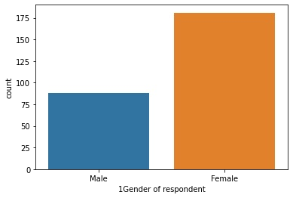

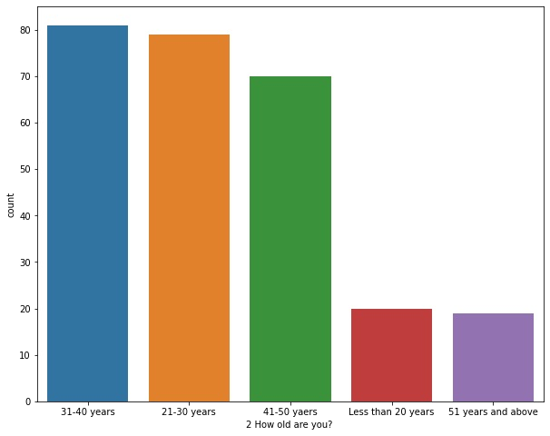

ax= sns.countplot(x='1Gender of respondent',data = data) print(data['1Gender of respondent'].value_counts())
Female Male
181
88
Name: 1Gender of respondent, dtype: int64
In the data we can see clearly that there females are more who shpping more than Males
plt.figure(figsize=(10,8))
ax= sns.countplot(x='2 How old are you? ',data = data)
Mostly people who are in the age from 21 to 50 years shoppings more as compared to teenagers and more than 51 years
plt.figure(figsize=(25,5)) ax= sns.countplot(x='3 Which city do you shop online from?',data = data) print(data['3 Which city do you shop online from?'].value_counts())
Delhi | 58
Greater Noida | 43
Noida | 40
Bangalore | 37
Karnal | 27
Solan | 18
Ghaziabad | 18

Slide 6
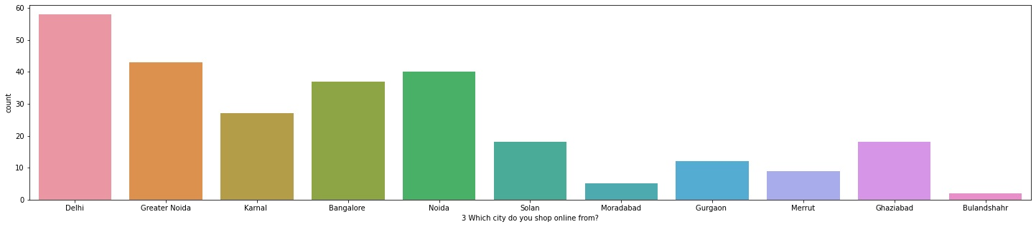

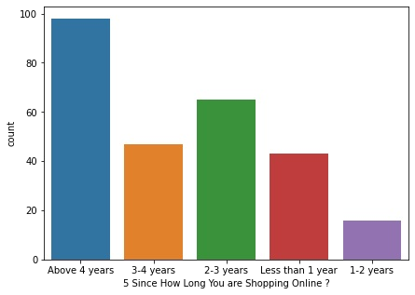

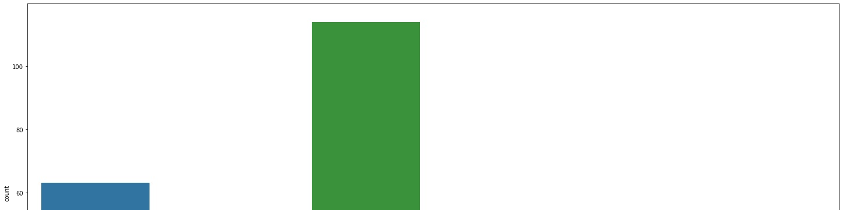
Gurgaon | 12
Merrut | 9
Moradabad | 5
Bulandshahr | 2
Name: 3 Which city do you shop online from?, dtype: int64
People from Delhi or metropolitian city doing shoppings more online
plt.figure(figsize=(7,5)) ax= sns.countplot(x='5 Since How Long You are Shopping Online ?',data = data) print(data['5 Since How Long You are Shopping Online ?'].value_counts())
Above 4 years | 98
2-3 years | 65
3-4 years | 47
Less than 1 year | 43
1-2 years | 16
Name: 5 Since How Long You are Shopping Online ?, dtype: int64
There are abt 98 people as the data shows which are maximum from the dataset who loves shopping online since more than 4 years
plt.figure(figsize=(25,12)) ax= sns.countplot(x='6 How many times you have made an online purchase in the past 1 year?',data = data) print(data['6 How many times you have made an online purchase in the past 1 year?'].value_counts())
Less than 10 times | 114
31-40 times | 63
41 times and above | 47
11-20 times | 29
21-30 times | 10
42 times and above | 6
Name: 6 How many times you have made an online purchase in the past 1 year?, dtype: int64

Slide 7
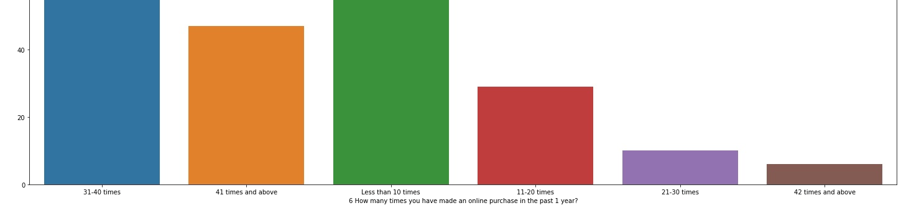

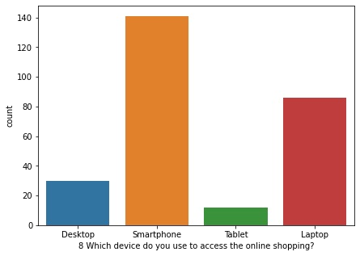
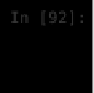
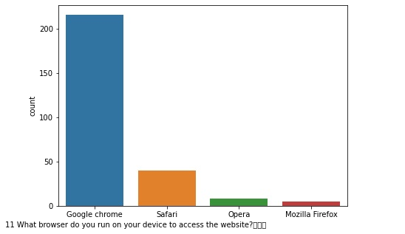
There are max people(114) who purchased (Less than 10 times) online in the past 1 year however there are 120+ people who purchased more than 31 items in a year
plt.figure(figsize=(7,5)) ax= sns.countplot(x='8 Which device do you use to access the online shopping?',data = data) print(data['8 Which device do you use to access the online shopping?'].value_counts())
Smartphone | 141
Laptop | 86
Desktop | 30
Tablet | 12
Name: 8 Which device do you use to access the online shopping?, dtype: int64
Mostly people uses their phones or lapies for online shopping
plt.figure(figsize=(7,5)) ax= sns.countplot(x='11 What browser do you run on your device to access the website?\t\t\t print(data['11 What browser do you run on your device to access the website?\t\t\t
Google chrome | 216
Safari | 40
Opera | 8
Mozilla Firefox | 5
Name: 11 What browser do you run on your device to access the website?\t\t\t
, dtype: int64

Slide 8

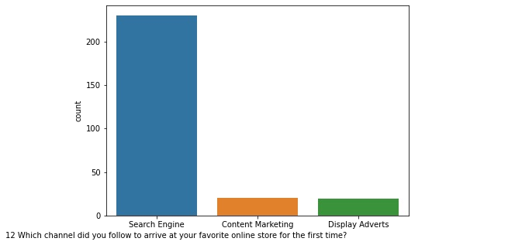
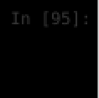
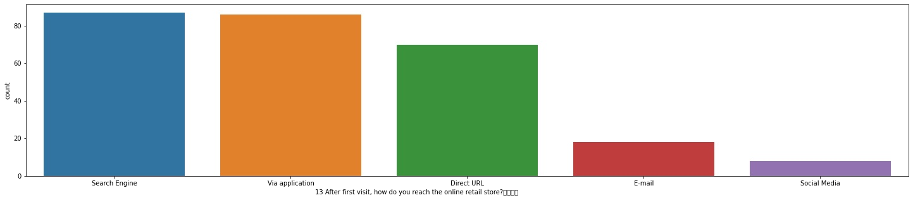

Most people using Google chrome browser to access the website
plt.figure(figsize=(7,5))
ax= sns.countplot(x='12 Which channel did you follow to arrive at your favorite online store for the first time? print(data['12 Which channel did you follow to arrive at your favorite online store for the first time?
Search Engine Content Marketing Display Adverts
230
20
19
Name: 12 Which channel did you follow to arrive at your favorite online store for the first time?
, dtype: int64
Maximum people followed Search Engine to arrive at their favorite online store for the first time
plt.figure(figsize=(25,5)) ax= sns.countplot(x='13 After first visit, how do you reach the online retail store?\t\t\t\t print(data['13 After first visit, how do you reach the online retail store?\t\t\t\t
Search Engine | 87
Via application | 86
Direct URL | 70
E-mail | 18
Social Media | 8
Name: 13 After first visit, how do you reach the online retail store?\t\t\t\t
, dtype: int64
Most people who once reached the website then after that they mostly download the app or again they searched from search engine
plt.figure(figsize=(25,5))
ax= sns.countplot(x='14 How much time do you explore the e- retail store before making a purchase decision? print(data['14 How much time do you explore the e- retail store before making a purchase decision?
more than 15 mins 6-10 mins
11-15 mins Less than 1 min 1-5 mins
123
71
46
15
14
Name: 14 How much time do you explore the e- retail store before making a purchase decision?
, dtype: int64

Slide 9
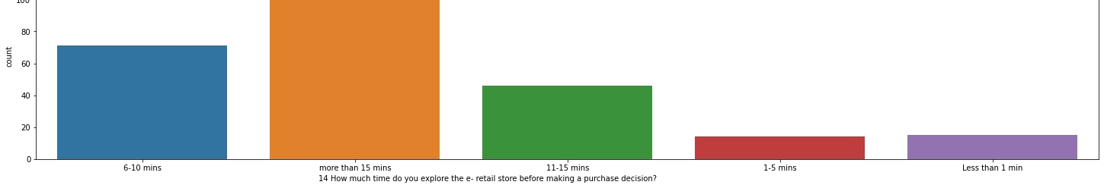
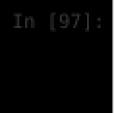
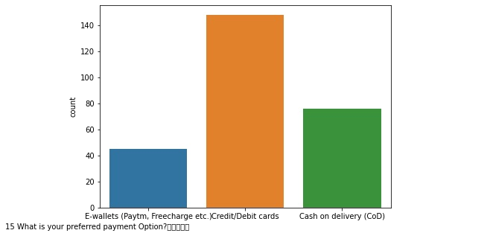
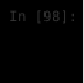
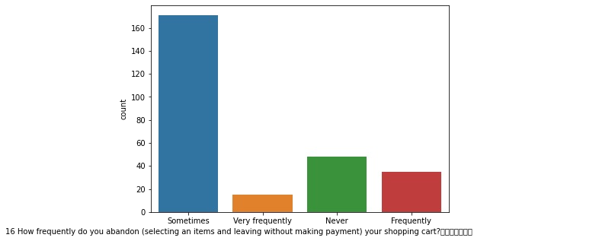
Max public took more than 15 min before making a purchase decision on the e-retail store
plt.figure(figsize=(7,5))
ax= sns.countplot(x='15 What is your preferred payment Option?\t\t\t\t\t print(data['15 What is your preferred payment Option?\t\t\t\t\t
Credit/Debit cards Cash on delivery (CoD)
E-wallets (Paytm, Freecharge etc.)
148
76
45
Name: 15 What is your preferred payment Option?\t\t\t\t\t
, dtype: int64
Maximum people used Credit cards/Debit cards as the preferred paymnet mode on the e-retail store and half of them used Cod
plt.figure(figsize=(7,5)) ax= sns.countplot(x='16 How frequently do you abandon (selecting an items and leaving without making payment) yo print(data['16 How frequently do you abandon (selecting an items and leaving without making payment) your shoppi
Sometimes | 171
Never | 48
Frequently | 35
Very frequently | 15
Name: 16 How frequently do you abandon (selecting an items and leaving without making payment) your shopping cart
?\t\t\t\t\t\t\t , dtype: int64
Max people on the e-retail store are those who Sometimes abondon their cart

Slide 10

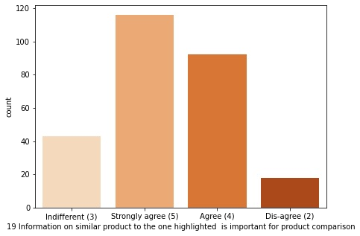

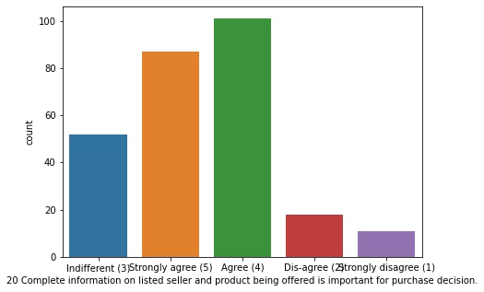

plt.figure(figsize=(7,5)) ax= sns.countplot(x='19 Information on similar product to the one highlighted is important for product comparis print(data['19 Information on similar product to the one highlighted is important for product comparison'].valu
Strongly agree (5) | 116
Agree (4) | 92
Indifferent (3) | 43
Dis-agree (2) | 18
Name: 19 Information on similar product to the one highlighted is important for product comparison, dtype: int64
Max people are Strongly agree and Agree about the fact that the Information on similar product to the one highlighted is important for product comparison
plt.figure(figsize=(7,5)) ax= sns.countplot(x='20 Complete information on listed seller and product being offered is important for purchas print(data['20 Complete information on listed seller and product being offered is important for purchase decisio
Agree (4) | 101
Strongly agree (5) | 87
Indifferent (3) | 52
Dis-agree (2) | 18
Strongly disagree (1) | 11
Name: 20 Complete information on listed seller and product being offered is important for purchase decision., dty pe: int64
Max People are Agree on the fact that Complete information on listed seller and product being offered is important for purchase decision.
plt.figure(figsize=(7,5)) ax= sns.countplot(x='21 All relevant information on listed products must be stated clearly',data = data,palette print(data['21 All relevant information on listed products must be stated clearly'].value_counts())
Agree (4) | 132
Strongly agree (5) | 107
Strongly disagree (1) | 18
Dis-agree (2) | 12

Slide 11
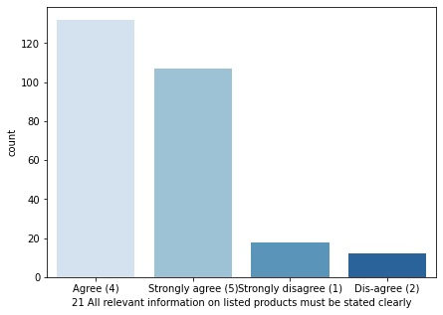
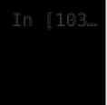
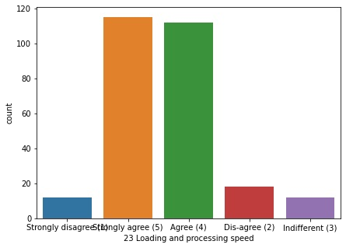

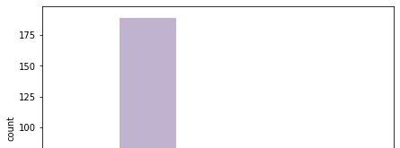
Name: 21 All relevant information on listed products must be stated clearly, dtype: int64
Max people are Agree on that All relevant information on listed products must be stated clearly
plt.figure(figsize=(7,5)) ax= sns.countplot(x='23 Loading and processing speed',data = data) print(data['23 Loading and processing speed'].value_counts())
Strongly agree (5) | 115
Agree (4) | 112
Dis-agree (2) | 18
Strongly disagree (1) | 12
Indifferent (3) | 12
Name: 23 Loading and processing speed, dtype: int64
There are very less Difference in the people who are Agree and Strongly agree on the Loading andprocessing speed
plt.figure(figsize=(7,5)) ax= sns.countplot(x='24 User friendly Interface of the website',data = data,palette = 'Accent') print(data['24 User friendly Interface of the website'].value_counts())
Strongly agree (5) | 189
Agree (4) | 45
Strongly disagree (1) | 18
Dis-agree (2) | 12
Indifferent (3) | 5
Name: 24 User friendly Interface of the website, dtype: int64

Slide 12
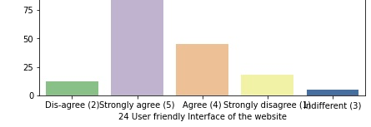

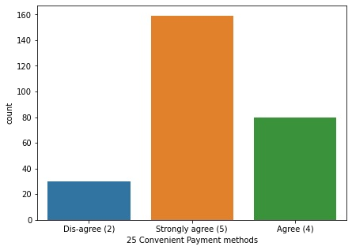
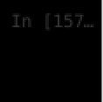
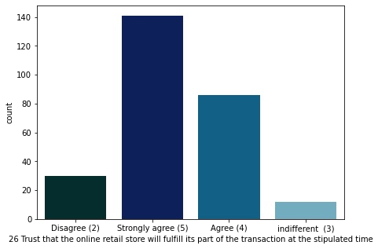
Max people are Strongly Agree on the fact the website is User friendly Interface
plt.figure(figsize=(7,5))
ax= sns.countplot(x='25 Convenient Payment methods',data = data) print(data['25 Convenient Payment methods'].value_counts())
Strongly agree (5)
Agree (4)
Dis-agree (2)
159
80
30
Name: 25 Convenient Payment methods, dtype: int64
max people are Strongly agree on the methods used by the websites for payments are convinient
plt.figure(figsize=(7,5))
ax= sns.countplot(x='26 Trust that the online retail store will fulfill its part of the transaction at the stipu print(data['26 Trust that the online retail store will fulfill its part of the transaction at the stipulated tim
Strongly agree (5)
Agree (4)
Disagree (2)
indifferent (3)
141
86
30
12
Name: 26 Trust that the online retail store will fulfill its part of the transaction at the stipulated time, dtyp e: int64
ABout 140 people who are Strongly Agree on the Trust that the online retail store will fulfill its part of the transaction at the stipulated time

Slide 13

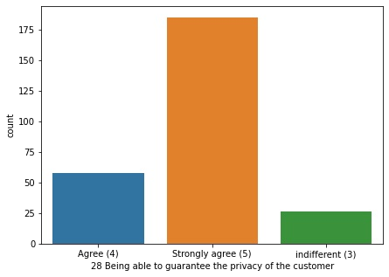

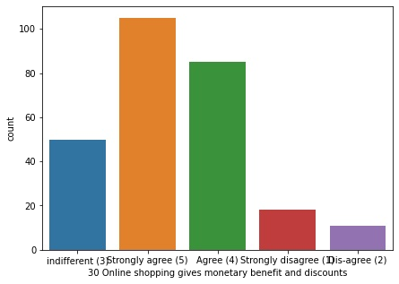


plt.figure(figsize=(7,5))
ax= sns.countplot(x='28 Being able to guarantee the privacy of the customer',data = data) print(data['28 Being able to guarantee the privacy of the customer'].value_counts())
Strongly agree (5)
Agree (4)
indifferent (3)
185
58
26
Name: 28 Being able to guarantee the privacy of the customer, dtype: int64
plt.figure(figsize=(7,5))
ax= sns.countplot(x='30 Online shopping gives monetary benefit and discounts',data = data) print(data['30 Online shopping gives monetary benefit and discounts'].value_counts())
Strongly agree (5)
Agree (4)
indifferent (3)
Strongly disagree (1)
Dis-agree (2)
105
85
50
18
11
Name: 30 Online shopping gives monetary benefit and discounts, dtype: int64
There a lot of people who thimks since Online Shopping came it gives people monetary benefit and discounts
plt.figure(figsize=(7,5))
ax= sns.countplot(x='31 Enjoyment is derived from shopping online',data = data) print(data['31 Enjoyment is derived from shopping online'].value_counts())
Strongly agree (5)
indifferent (3)
Agree (4)
Strongly disagree (1)
Dis-agree (2)
86
75
59
30
19
Name: 31 Enjoyment is derived from shopping online, dtype: int64

Slide 14
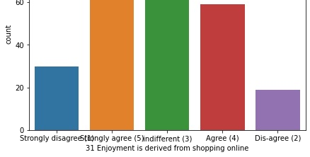

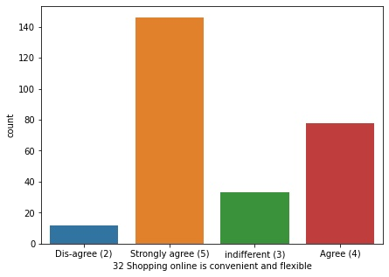

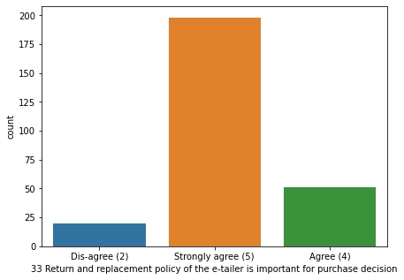
There are a lot of people who are Strongly agree on the fact that Enjoyment is derived from shopping online but there are approximately equal indifferent people who thinks not
plt.figure(figsize=(7,5))
ax= sns.countplot(x='32 Shopping online is convenient and flexible',data = data) print(data['32 Shopping online is convenient and flexible'].value_counts())
Strongly agree (5)
Agree (4)
indifferent (3)
Dis-agree (2)
146
78
33
12
Name: 32 Shopping online is convenient and flexible, dtype: int64
As we know that the technology makes life easier and the people in the data also shows that max people are Strongly agree on the fact that Shopping online is convenient and flexible
plt.figure(figsize=(7,5))
ax= sns.countplot(x='33 Return and replacement policy of the e-tailer is important for purchase decision',data =
print(data['33 Return and replacement policy of the e-tailer is important for purchase decision'].value_counts()
Strongly agree (5)
Agree (4)
Dis-agree (2)
198
51
20
Name: 33 Return and replacement policy of the e-tailer is important for purchase decision, dtype: int64

Slide 15

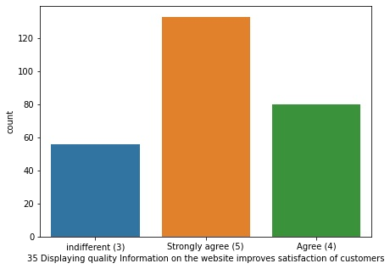

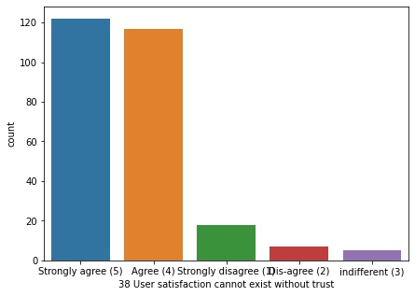

Max people are strongly agree on the Return and replacement policy of the e-tailer is important for purchase decision
plt.figure(figsize=(7,5))
ax= sns.countplot(x='35 Displaying quality Information on the website improves satisfaction of customers',data =
print(data['35 Displaying quality Information on the website improves satisfaction of customers'].value_counts()
Strongly agree (5)
Agree (4)
indifferent (3)
133
80
56
Name: 35 Displaying quality Information on the website improves satisfaction of customers, dtype: int64
Satisfaction is the most important function in the terms of any buisness to satisfied the customer and hence Max people in the data are Strongly agree in Displaying quality Information on the website improves satisfaction of customers
plt.figure(figsize=(7,5))
ax= sns.countplot(x='38 User satisfaction cannot exist without trust',data = data) print(data['38 User satisfaction cannot exist without trust'].value_counts())
Strongly agree (5)
Agree (4)
Strongly disagree (1)
Dis-agree (2)
indifferent (3)
122
117
18
7
5
Name: 38 User satisfaction cannot exist without trust, dtype: int64
A lot of people Thinks and its also a fact tht the people whio are strongly agree about that User satisfaction cannot exist without trust
plt.figure(figsize=(7,5))
ax= sns.countplot(x='39 Offering a wide variety of listed product in several category',data = data) print(data['39 Offering a wide variety of listed product in several category'].value_counts())
Strongly agree (5)
Agree (4)
indifferent (3)
111
94
57

Slide 16
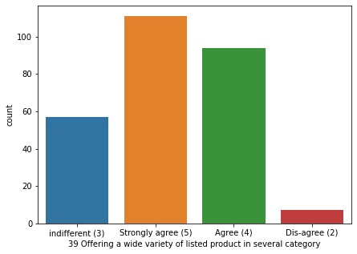

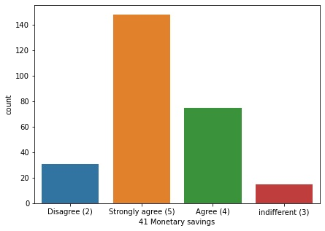
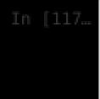
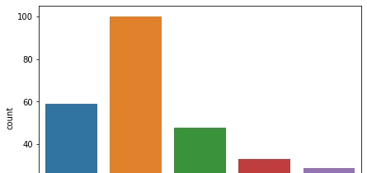
Dis-agree (2) 7
Name: 39 Offering a wide variety of listed product in several category, dtype: int64
plt.figure(figsize=(7,5))
ax= sns.countplot(x='41 Monetary savings',data = data) print(data['41 Monetary savings'].value_counts())
Strongly agree (5)
Agree (4)
Disagree (2)
indifferent (3)
148
75
31
15
Name: 41 Monetary savings, dtype: int64
Max people thinks that online shopping is a Monetary savings
plt.figure(figsize=(7,5))
ax= sns.countplot(x='44 Shopping on your preferred e-tailer enhances your social status',data = data) print(data['44 Shopping on your preferred e-tailer enhances your social status'].value_counts())
indifferent (3)
Agree (4)
Strongly agree (5)
Strongly disagree (1)
Dis-agree (2)
100
59
48
33
29
Name: 44 Shopping on your preferred e-tailer enhances your social status, dtype: int64

Slide 17
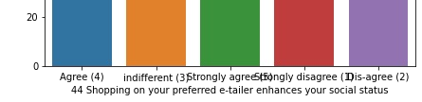

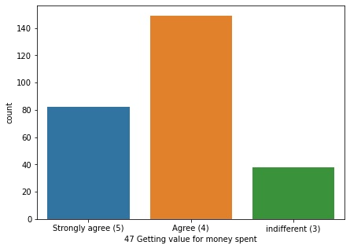
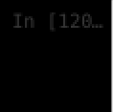
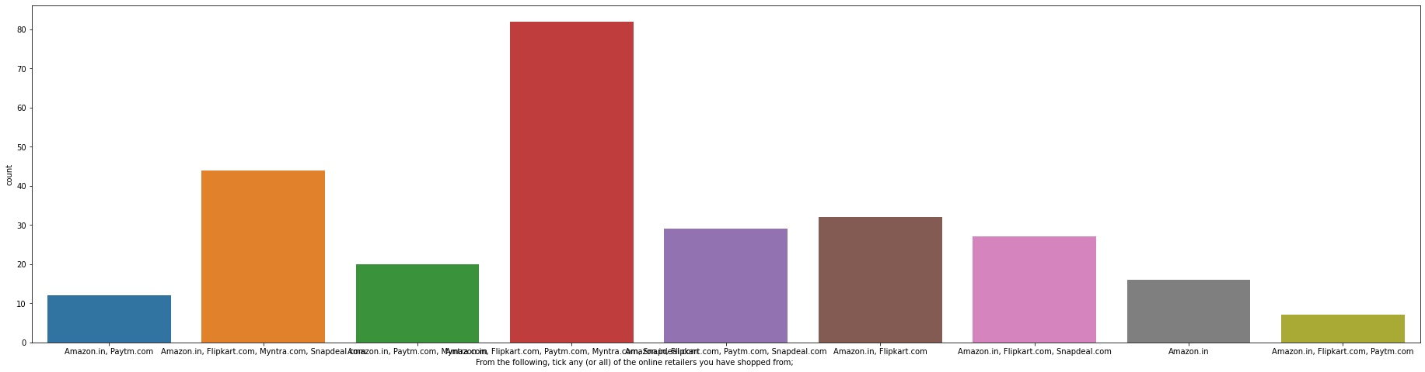
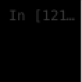
plt.figure(figsize=(7,5))
ax= sns.countplot(x='47 Getting value for money spent',data = data) print(data['47 Getting value for money spent'].value_counts())
Agree (4)
Strongly agree (5)
indifferent (3)
149
82
38
Name: 47 Getting value for money spent, dtype: int64
Max people are Agree that they are Getting value for money spent
plt.figure(figsize=(32,8)) ax= sns.countplot(x='From the following, tick any (or all) of the online retailers you have shopped from; print(data['From the following, tick any (or all) of the online retailers you have shopped from;
Amazon.in, Flipkart.com, Paytm.com, Myntra.com, Snapdeal.com | 82
Amazon.in, Flipkart.com, Myntra.com, Snapdeal.com | 44
Amazon.in, Flipkart.com | 32
Amazon.in, Flipkart.com, Paytm.com, Snapdeal.com | 29
Amazon.in, Flipkart.com, Snapdeal.com | 27
Amazon.in, Paytm.com, Myntra.com | 20
Amazon.in | 16
Amazon.in, Paytm.com | 12
Amazon.in, Flipkart.com, Paytm.com | 7
Name: From the following, tick any (or all) of the online retailers you have shopped from;
, dtype: int64
Maximum people are those who ticks on the online retailers they have shopped from Amazon.in, Flipkart.com, Paytm.com, Myntra.com, Snapdeal.com
plt.figure(figsize=(35,12))
ax= sns.countplot(x='Easy to use website or application',data = data) print(data['Easy to use website or application'].value_counts())

Slide 18
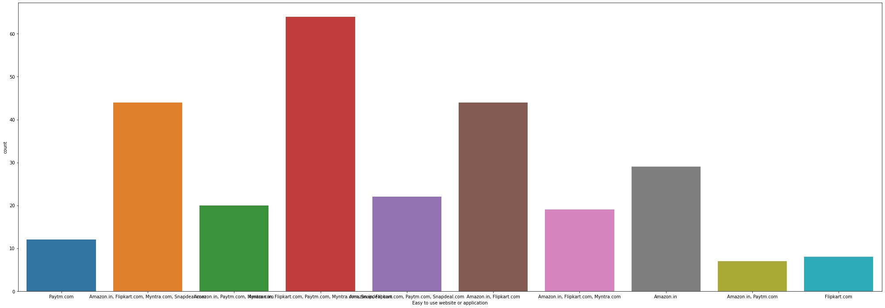

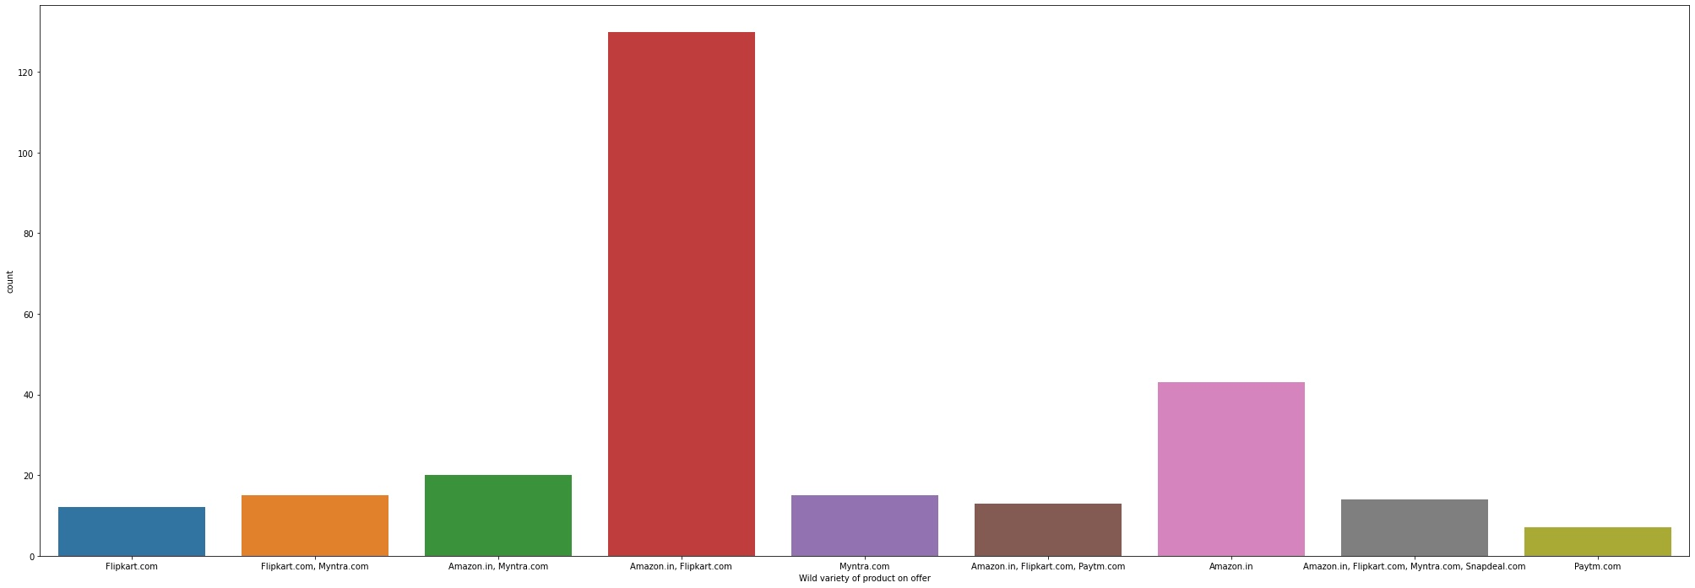
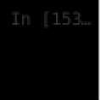
Amazon.in, Flipkart.com, Paytm.com, Myntra.com, Snapdeal.com | 64
Amazon.in, Flipkart.com, Myntra.com, Snapdeal.com | 44
Amazon.in, Flipkart.com | 44
Amazon.in | 29
Amazon.in, Flipkart.com, Paytm.com, Snapdeal.com | 22
Amazon.in, Paytm.com, Myntra.com | 20
Amazon.in, Flipkart.com, Myntra.com | 19
Paytm.com | 12
Flipkart.com | 8
Amazon.in, Paytm.com | 7
Name: Easy to use website or application, dtype: int64
MAx people said that they feel easy to use all website or applications
plt.figure(figsize=(35,12)) ax= sns.countplot(x='Wild variety of product on offer',data = data) print(data['Wild variety of product on offer'].value_counts())
Amazon.in, Flipkart.com | 130
Amazon.in | 43
Amazon.in, Myntra.com | 20
Flipkart.com, Myntra.com | 15
Myntra.com | 15
Amazon.in, Flipkart.com, Myntra.com, Snapdeal.com | 14
Amazon.in, Flipkart.com, Paytm.com | 13
Flipkart.com | 12
Paytm.com | 7
Name: Wild variety of product on offer, dtype: int64
Max people gives suggestions that there are a wide vaiety of products on offer on Amazon.in, Flipkart.com
plt.figure(figsize=(35,12)) ax= sns.countplot(x='Reliability of the website or application',data = data,palette = 'Blues') print(data['Reliability of the website or application'].value_counts())
Amazon.in | 61
Amazon.in, Flipkart.com | 50
Amazon.in, Flipkart.com, Paytm.com | 36
Amazon.in, Paytm.com, Myntra.com | 35
Amazon.in, Flipkart.com, Snapdeal.com | 18

Slide 19
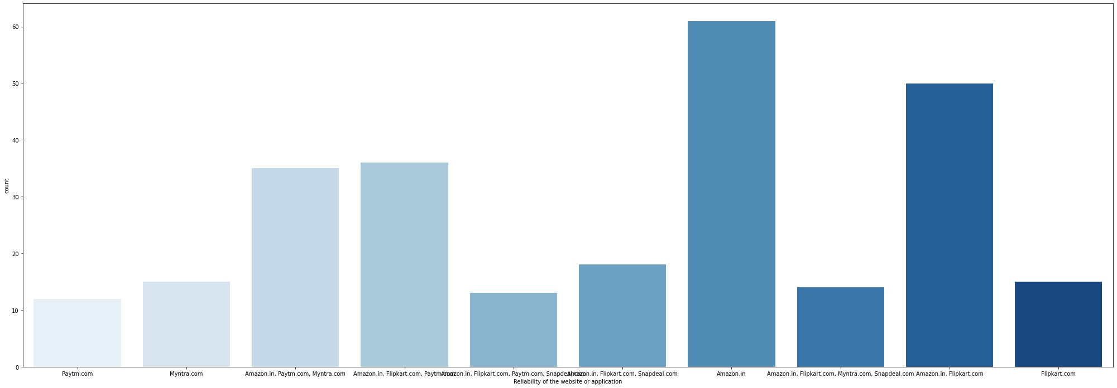

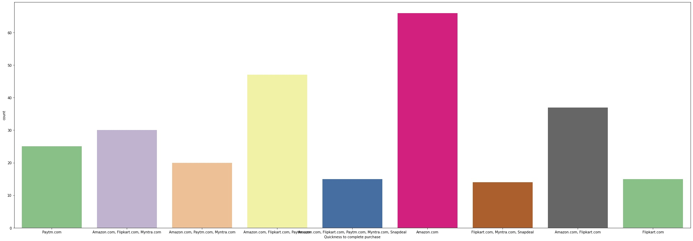

Myntra.com | 15
Flipkart.com | 15
Amazon.in, Flipkart.com, Myntra.com, Snapdeal.com | 14
Amazon.in, Flipkart.com, Paytm.com, Snapdeal.com | 13
Paytm.com | 12
Name: Reliability of the website or application, dtype: int64
MAX people thinks that Amazon and flipkart are the most Reliable website or application
plt.figure(figsize=(35,12)) ax= sns.countplot(x='Quickness to complete purchase',data = data,palette = 'Accent') print(data['Quickness to complete purchase'].value_counts())
Amazon.com | 66
Amazon.com, Flipkart.com, Paytm.com | 47
Amazon.com, Flipkart.com | 37
Amazon.com, Flipkart.com, Myntra.com | 30
Paytm.com | 25
Amazon.com, Paytm.com, Myntra.com | 20
Amazon.com, Flipkart.com, Paytm.com, Myntra.com, Snapdeal | 15
Flipkart.com | 15
Flipkart.com, Myntra.com, Snapdeal | 14
Name: Quickness to complete purchase, dtype: int64
Amazon.com e-store is the Quicker store to complete purchase by max people
plt.figure(figsize=(35,12)) ax= sns.countplot(x='Speedy order delivery ',data = data) print(data['Speedy order delivery '].value_counts())
Amazon.in | 107
Amazon.in, Flipkart.com | 82
Amazon.in, Flipkart.com, Snapdeal.com | 36
Amazon.in, Flipkart.com, Myntra.com | 15
Flipkart.com | 15
Flipkart.com, Myntra.com, Snapdeal.com | 14
Name: Speedy order delivery , dtype: int64

Slide 20
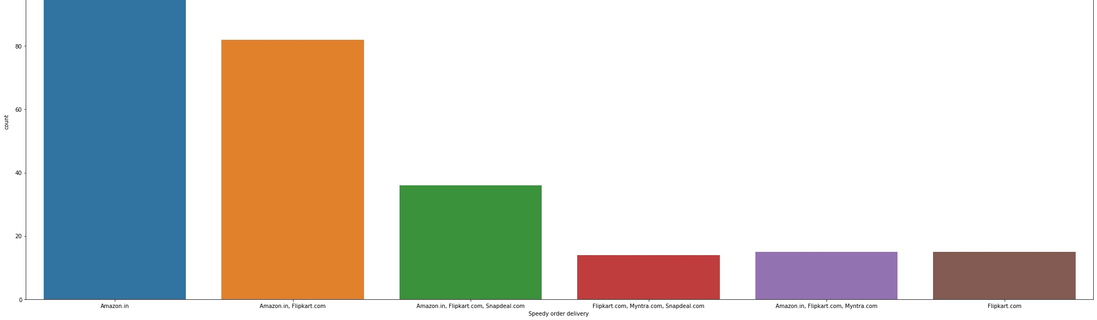




A lot of people htinks that amzon is the superfast in the terms of deleivering our products
plt.figure(figsize=(35,12)) ax= sns.countplot(x='Privacy of customers’ information',data = data) print(data['Privacy of customers’ information'].value_counts())
Amazon.in | 71
Amazon.in, Flipkart.com | 54
Amazon.in, Flipkart.com, Myntra.com | 25
Amazon.in, Flipkart.com, Paytm.com, Myntra.com, Snapdeal.com | 24
Paytm.com | 18
Myntra.com | 15
Amazon.in, Paytm.com | 15
Flipkart.com | 15
Amazon.in, Flipkart.com, Myntra.com, Snapdeal.com | 14
Amazon.in, Flipkart.com, Paytm.com | 11
Amazon.in, Flipkart.com, Snapdeal.com | 7
Name: Privacy of customers’ information, dtype: int64
Amazon gives Privacy of customers’ information maximum
plt.figure(figsize=(35,12))
ax= sns.countplot(x='Perceived Trustworthiness',data = data) print(data['Perceived Trustworthiness'].value_counts())
Amazon.in
Amazon.in, Flipkart.com, Snapdeal.com Amazon.in, Myntra.com
Amazon.in, Flipkart.com Flipkart.com
Amazon.in, Flipkart.com, Myntra.com, Snapdeal.com Myntra.com
Amazon.in, Flipkart.com, Paytm.com, Myntra.com, Snapdeal.com Amazon.in, Flipkart.com, Paytm.com
Name: Perceived Trustworthiness, dtype: int64
76
36
35
31
27
25
15
13
11

Slide 21





Amazon Perceived Trustworthiness from the customers as they thinks it is most trustworthy website or application
plt.figure(figsize=(35,12)) ax= sns.countplot(x='Presence of online assistance through multi-channel',data = data,palette = 'twilight') print(data['Presence of online assistance through multi-channel'].value_counts())
Amazon.in, Flipkart.com, Myntra.com, Snapdeal | 61
Amazon.in | 60
Amazon.in, Flipkart.com | 39
Amazon.in, Snapdeal | 26
Myntra.com | 20
Amazon.in, Flipkart.com, Myntra.com | 15
Amazon.in, Myntra.com | 15
Amazon.in, Flipkart.com, Paytm.com | 13
Paytm.com | 12
Flipkart.com | 8
Name: Presence of online assistance through multi-channel, dtype: int64
max people suggests that Amazon.in, Flipkart.com, Myntra.com, Snapdeal e -store has online assistance through multi-channel
plt.figure(figsize=(35,12)) ax= sns.countplot(x='Longer time in displaying graphics and photos (promotion, sales period)',data = data) print(data['Longer time in displaying graphics and photos (promotion, sales period)'].value_counts())
Amazon.in, Flipkart.com | 60
Amazon.in | 39
Myntra.com | 35
Snapdeal.com | 34
Myntra.com, Snapdeal.com | 25
Flipkart.com, Snapdeal.com | 19
Paytm.com | 15
Flipkart.com | 15
Amazon.in, Myntra.com, Snapdeal.com | 14
Amazon.in, Paytm.com | 13
Name: Longer time in displaying graphics and photos (promotion, sales period), dtype: int64

Slide 22





Amazon.in, Flipkart.com have Longer time in displaying graphics and photos (promotion, sales period
plt.figure(figsize=(35,12)) ax= sns.countplot(x='Limited mode of payment on most products (promotion, sales period)',data = data) print(data['Limited mode of payment on most products (promotion, sales period)'].value_counts())
Snapdeal.com | 87
Amazon.in | 62
Flipkart.com | 31
Amazon.in, Flipkart.com | 29
Paytm.com | 25
Paytm.com, Snapdeal.com | 15
Amazon.in, Paytm.com | 13
Myntra.com, Snapdeal.com | 7
Name: Limited mode of payment on most products (promotion, sales period), dtype: int64
Max customers suggests that Snapdeal.com have Limited mode of payment on most products (promotion, sales period)
plt.figure(figsize=(35,12)) ax= sns.countplot(x='Longer delivery period',data = data,palette = 'ocean') print(data['Longer delivery period'].value_counts())
Paytm.com | 72
Snapdeal.com | 64
Flipkart.com | 44
Amazon.in | 37
Paytm.com, Snapdeal.com | 26
Myntra.com | 26
Name: Longer delivery period, dtype: int64

Slide 23




Paytm.com gives Longer delivery period as max customer suggest whereas Myntra.com have very less longer period
plt.figure(figsize=(35,12)) ax= sns.countplot(x='Website is as efficient as before',data = data) print(data['Website is as efficient as before'].value_counts())
Amazon.in | 94
Flipkart.com | 47
Amazon.in, Flipkart.com | 45
Amazon.in, Flipkart.com, Paytm.com | 25
Amazon.in, Paytm.com | 18
Paytm.com | 15
Myntra.com, Snapdeal.com | 14
Snapdeal.com | 11
Name: Website is as efficient as before, dtype: int64
Max customers thinks that Amazon.in is the Website is as efficient as before
plt.figure(figsize=(35,12)) ax= sns.countplot(x='Which of the Indian online retailer would you recommend to a friend?',data = data,palette = print(data['Which of the Indian online retailer would you recommend to a friend?'].value_counts())
Amazon.in | 79
Amazon.in, Flipkart.com | 62
Flipkart.com | 39
Amazon.in, Myntra.com | 30
Amazon.in, Paytm.com, Myntra.com | 20
Amazon.in, Flipkart.com, Myntra.com | 15
Amazon.in, Paytm.com | 13
Flipkart.com, Paytm.com, Myntra.com, snapdeal.com | 11
Name: Which of the Indian online retailer would you recommend to a friend?, dtype: int64
Amazon looks best but Amazon is the Foreign retailer, if i want to suggest an Indian retailer to my friend so I ll suggest Flipkart.com because it is an Indian as well as it have also best reviews( nearly equals as amazon) from the dataset

Slide 24
CONCLUSIONS :-
AS the above analysis from the customers feedback it clearly gives that the Amazon is the best online store and have there loyal customers who mostly times purchased items as they visit and have trust on the site and Amazon also provide Customer fully satisfaction (by means of providing fast delievery , having quality products,monetary savings etc as we analyse and there privacy…
However flipkart also performs better and have good reviews from the customers feedback but the Amazon is on the Top of the list in every categories

